Slide 1


Electricity Networks Innovation Strategy
March 2026

Slide 2
Contents
Foreword…………………………………………………………….. | 04 | Maintain a Safe and Resilient Network…………………. | 16
Electricity Networks Innovation Strategy – Vision……… | 05 | Support Innovation Cultures and Knowledge Sharing… | 17
Key Challenges for a Decarbonised Electricity System.. | 06 | 10. Shared Network innovation themes……………............ | 18
Building a Net-Zero‑Ready Energy System………………. | 07 | Data and digitalisation……………………………………. | 19
Electricity Networks Innovation Strategy – Objectives… | 08 | Flexibility and market evolution..................................... | 20
Electricity Networks Innovation Strategy – Themes……. | 09 | Net-Zero and the energy transition……………………… | 21
Innovation to Date – Turning ideas into capabilities.…… | 10 | Optimised assets and practices…………………………. | 22
Electricity Networks Innovation Strategy – Horizons Development …………………………………………………… | 11 | Supporting consumers in vulnerable situations………… | 23
Innovation Horizons ………………………………………….. | 12 | Whole energy system…………………………………….. | 24
Innovation Objectives ………………………………………… | 13 | 11. In Summary…………………………………………………… | 25
Deliver an Environmentally Sustainable Network............... | 14 | 12. Glossary………………………………………………………. | 28
Meet the Needs of Consumers and Network Users………. | 15

Slide 3
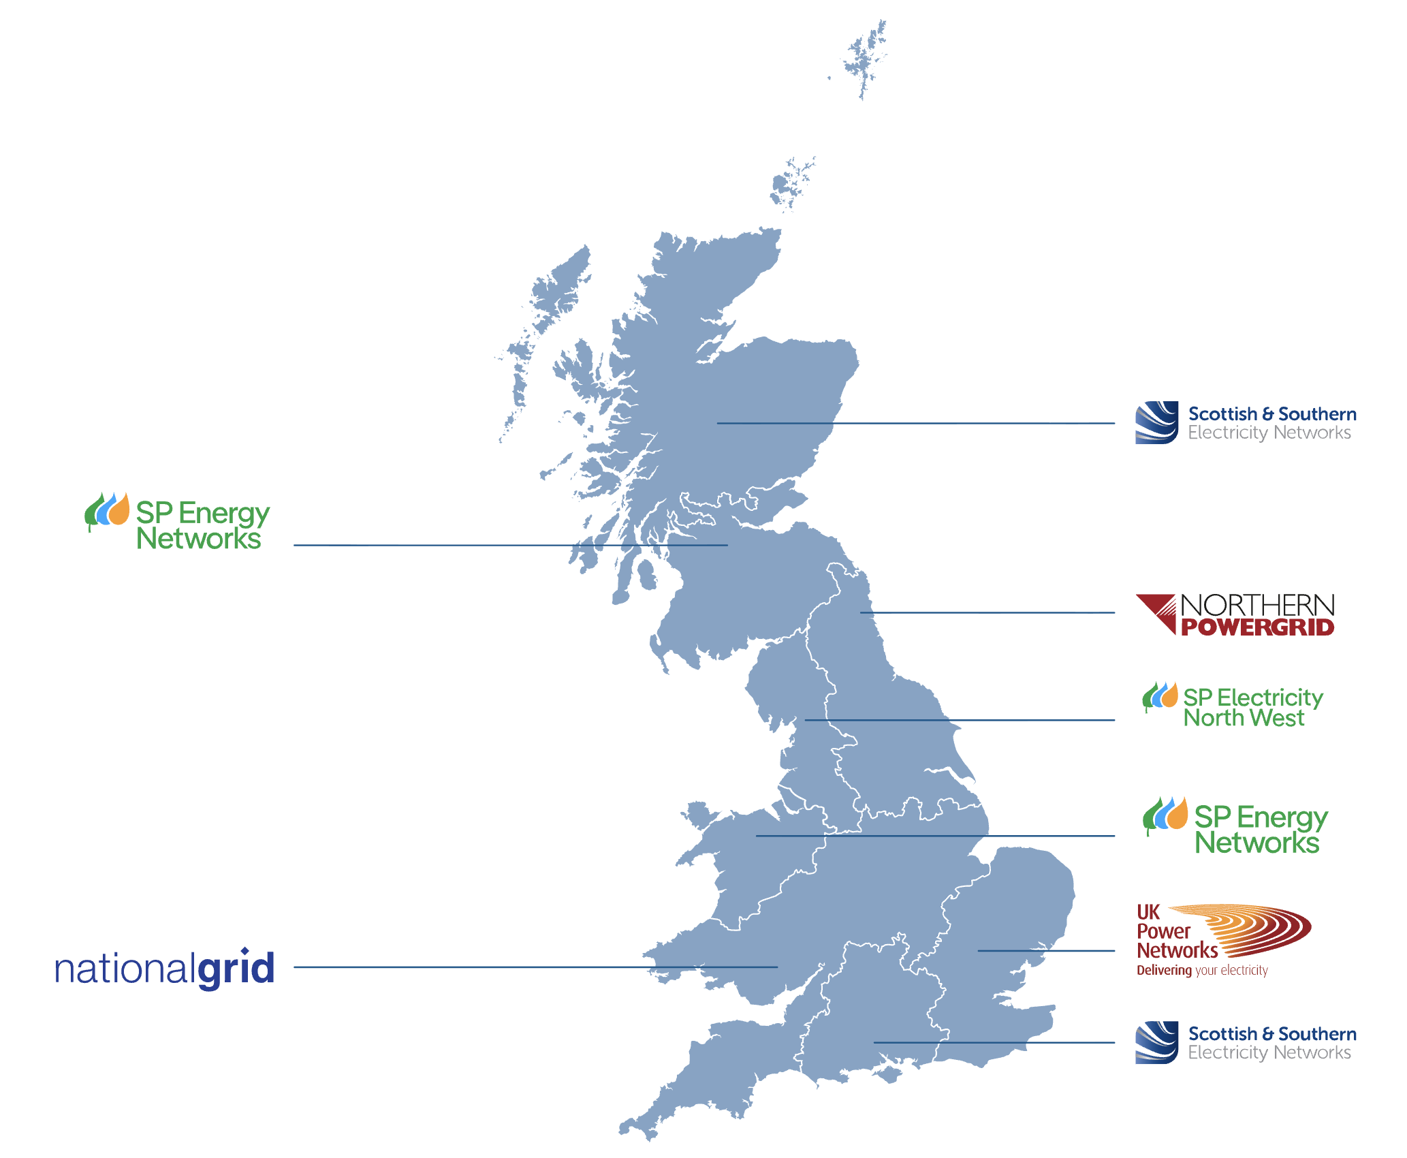
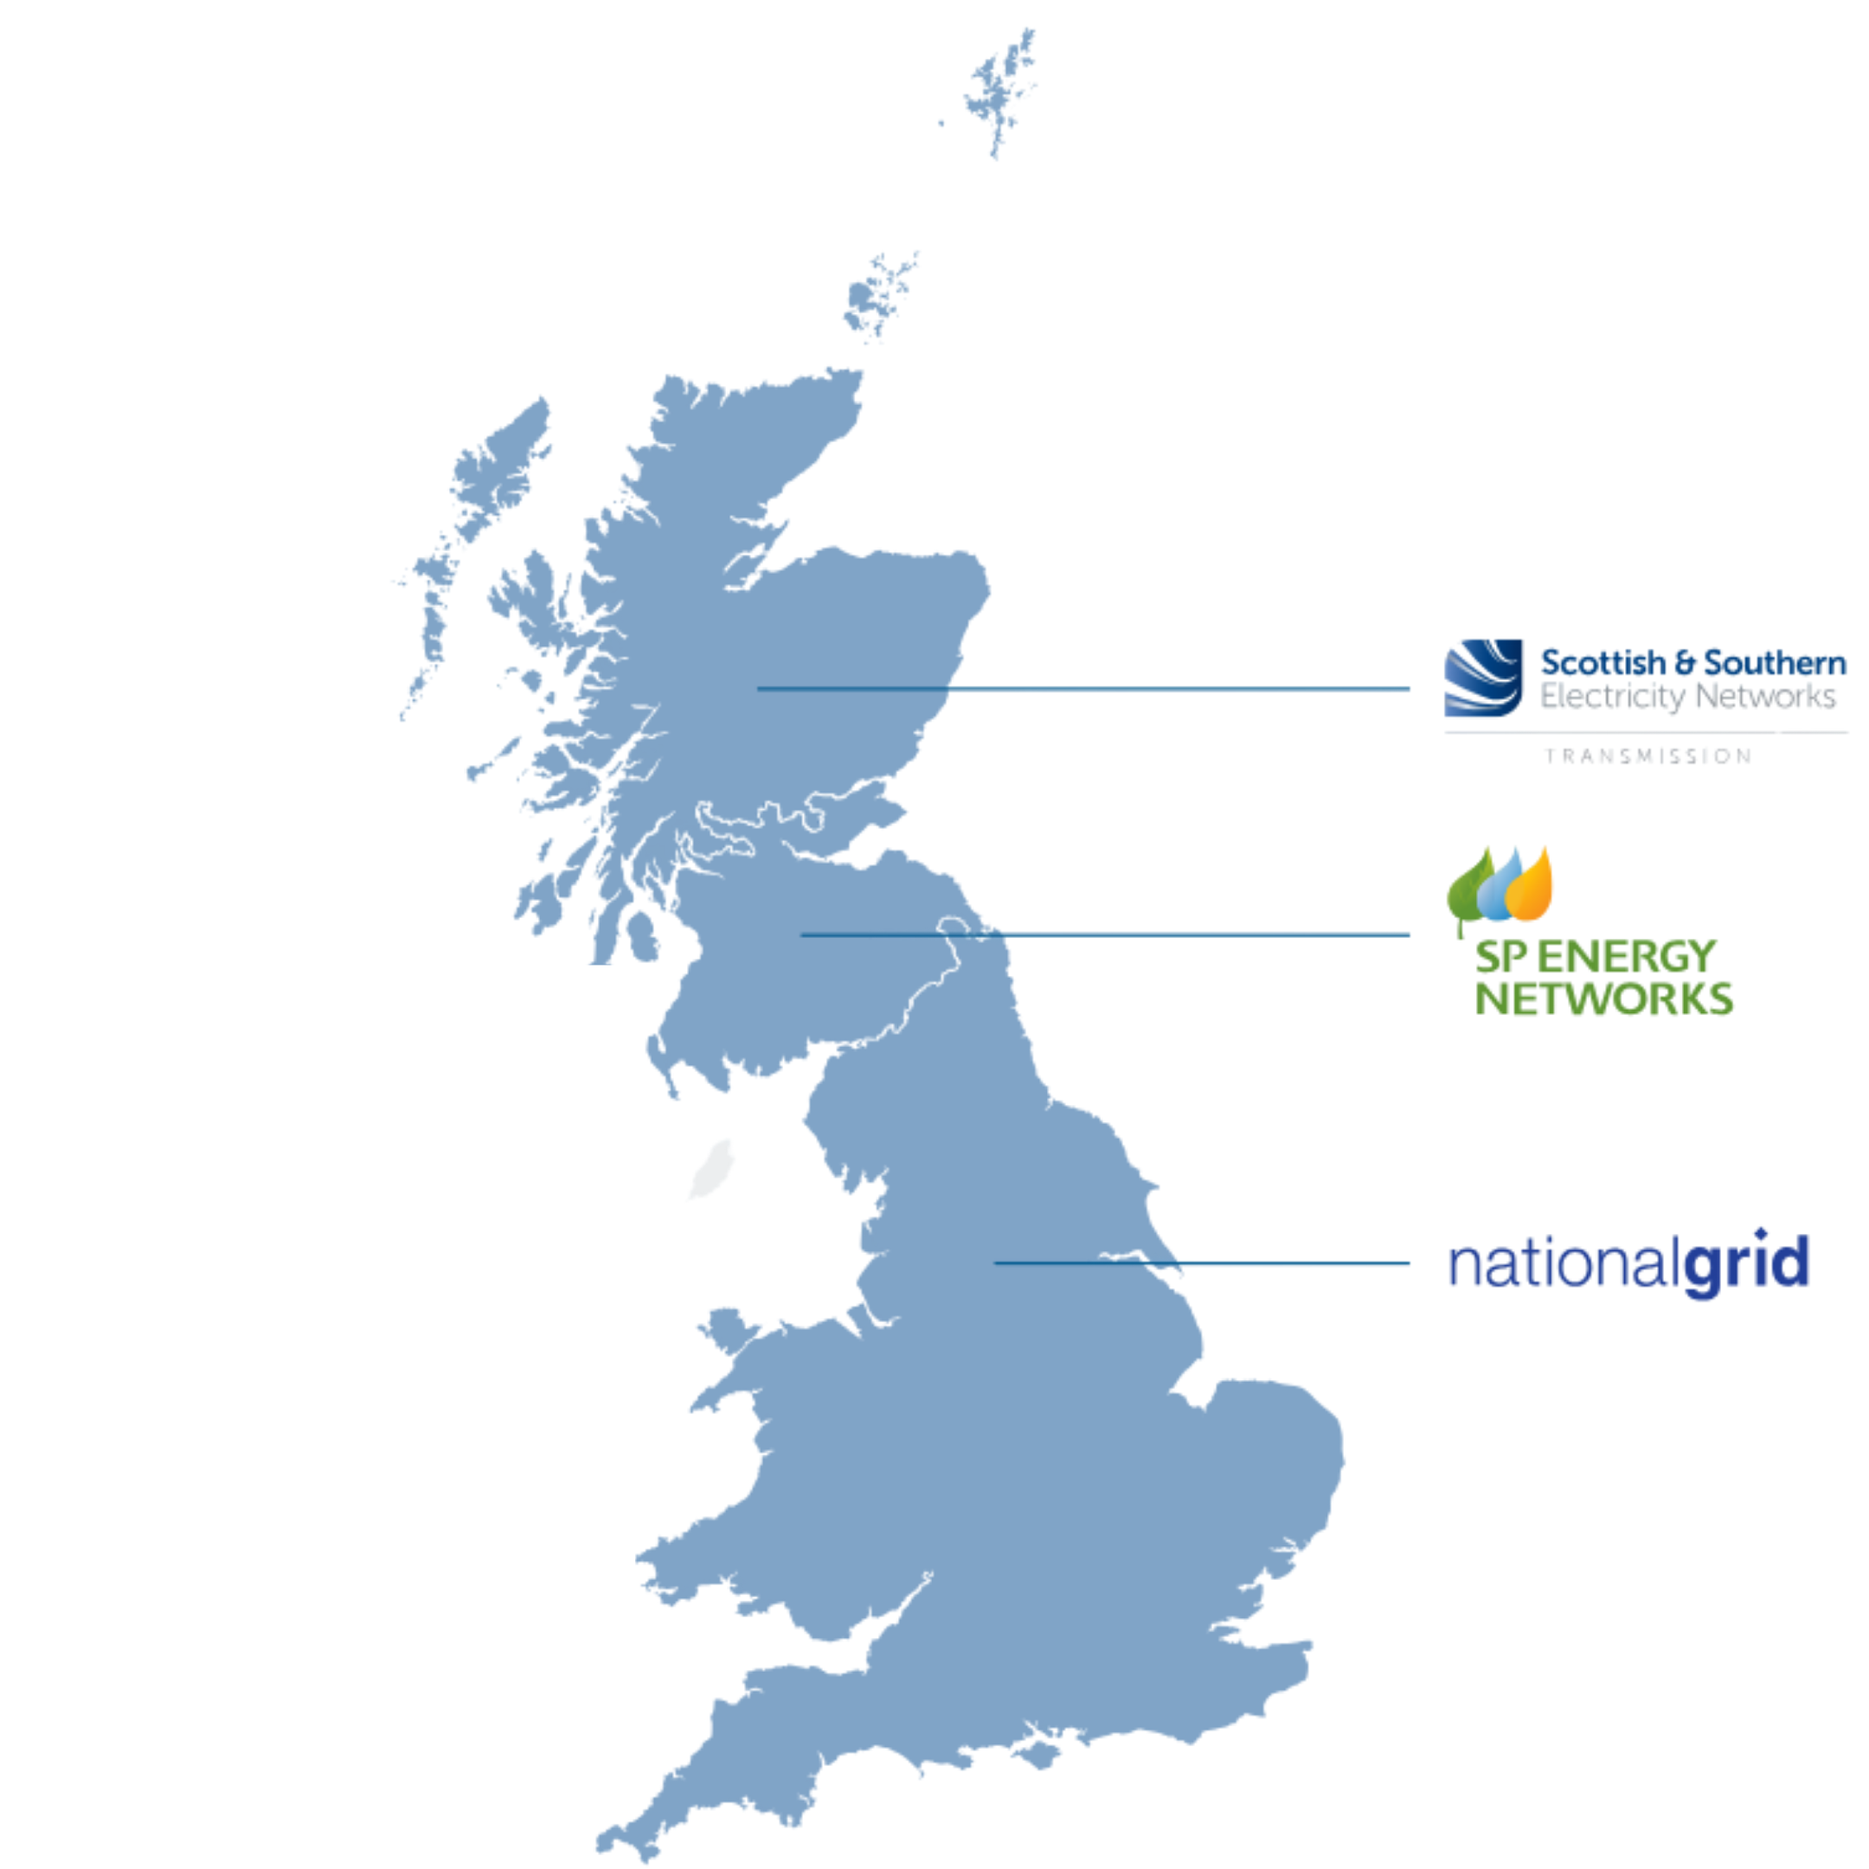
Electricity Network Companies
Distribution Network Operators (DNOs)
Transmission System Operators (TSOs)

Slide 4
Foreword
The GB’s electricity networks are going through unprecedented change and innovation. As we look to invest over £100bn into our grid infrastructure out to 2031, this once in a generation opportunity will support the deployment of low carbon technologies for households and business across the country.
Innovation into our electricity networks have maximised the efficiency of our existing infrastructure by supporting homes and businesses generate their own power which reduces overall peak demand. Our members remain focused on supporting this essential shift to low carbon technologies whilst ensuring that everyone with a role in the wider energy system stays involved and informed throughout the transition.
This innovation strategy demonstrates the value that network innovation has delivered to customers over the past decade. It highlights the projects that laid the groundwork for capabilities that are now business-as-usual (BAU) through innovation. These initiatives enabled advancements that we now take for granted but required significant innovation to achieve. For example, the networks have delivered over 3,000 innovation projects, enabling services such as real-time network controls, the optimisation of off-peak capacity, and faster decarbonised connections to become standardised practice.
The economic and energy landscape today brings both opportunities and challenges. Global supply chain pressures, an expected doubling of demand for electricity by 2050 and the need for increased resilience, means that innovation is vital for the ongoing security of our electricity system.
As we move forward, our members’ priority is to speed up and expand the great work already underway in electricity innovation. These projects and innovations are underpinned by a strong regulatory commitment, with the Network Innovation Allowance and Strategic Innovation funding delivering an investment of £415m into network innovation since 2021.
This year’s Electricity Networks Innovation Strategy sets out a clear perspective across three horizon periods, 5, 15 and 25 years which will define the innovation requirements that will enable the continued progression of our networks and the wider electricity system. These horizons provide clarity on the steps needed to achieve long-term goals, while ensuring flexibility to adapt to emerging technologies and market needs.
Our members are facilitating a strong culture of innovation which continues to inform this strategy. In recent years there have been major advances including digital tools, system flexibility and whole system coordination. With this innovation comes with the responsibility to ensure that these achievements benefit every consumer, including people with additional accessibility needs or specialist technical considerations.
Networks are now building on all this great work with this year’s strategy taking a longer-term view. We welcome the involvement of all stakeholders, policy makers, innovators and the public in helping to build an energy system that is resilient, efficient and fair for everyone.
Lawrence Slade
Chief Executive, ENA

Slide 5

Electricity Networks Innovation Strategy – Vision
Our vision is to support the GB’s full decarbonisation and enable a smart, resilient and inclusive energy system.
This future system will use advanced technologies, reliable data and sustainable practices. It will adapt to consumer needs, create value and help deliver the UK’s decarbonisation¹ commitments.
The ENA Innovation Strategy describes how this vision will be achieved. This strategy aligns transmission and distribution innovation around shared whole‑system goals, ensuring progress is coordinated across the entire GB electricity network.
It identifies the innovation gaps that must be addressed to meet environmental targets. It highlights the critical capabilities that need further development for networks to succeed in a rapidly changing energy landscape.
The ENA Innovation Strategy aims to help networks clearly articulate their long‑term system improvement objectives, identify near‑term priorities, and address urgent gaps, while developing the capabilities required for a future Net-Zero energy system.
ENA innovation approach embeds innovation into everyday network planning and delivery. It strengthens collaboration between industry, consumers and Ofgem. It also promotes transparency and shared learning. This ensures innovation remains aligned with policy, supports system‑wide outcomes and accelerates the transformation of the UK's energy system.
The 2026 Electricity Networks Innovation Strategy will be delivered as both a full document and a comprehensive online visual, combining a retrospective analysis of the capabilties innovation has delivered to date, with a forward outlook across the future horizons.
¹ as per the UK Government’s Net-Zero commitment

Slide 6
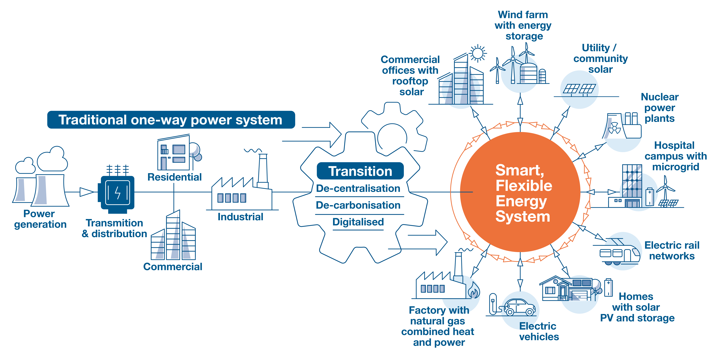
Key Challenges for a Decarbonised Electricity System
GB’s electricity system has already shifted from a centrally dominated model, in which a small number of large power stations drove long‑distance power flows, to a diverse mix of distributed, renewable and offshore generation. Although renewables now provide over half of GB electricity, major clusters such as offshore wind and remote onshore sites remain far from demand centres. This creates new power‑flow patterns and increases network complexity.
Electrification of homes, businesses and transport is changing demand patterns, creating new peaks but also opportunities for flexible use. As the system becomes more decentralised and digital, networks must connect customers quickly, move power efficiently and maintain secure operations.
There is no single solution to these challenges. A coordinated approach across the whole value chain is needed to deliver new infrastructure at pace while keeping costs fair, including:
New infrastructure to link generation zones and strengthen regional corridors.
Smarter use of existing assets to avoid unnecessary new build.
Better system visibility and control through data, automation and protection.
Scaled flexibility from storage, demand response and DSO services.
Faster, more consistent connections and effective queue reform.
End‑to‑end resilience, both cyber and physical.
This strategy highlights priorities:
Accelerate connections.
Unlock capacity.
Orchestrate flexibility.
Enhance resilience.
Digitise operations, so clean power reaches where the economy needs it.
Success depends on collaboration across network operators, regulators, developers, planners, flexibility providers and communities.
Only coordinated action can keep pace with the transition and ensure a smart, reliable system ready for Net-Zero.

Slide 7

Building a Net-Zero‑Ready Energy System
The transition to a Net-Zero‑ready system will place unprecedented pressure on infrastructure, operations and skills. Sustained innovation will be critical to expanding capacity, improving flexibility and ensuring the system can evolve at the pace required. This diagram highlights some of the key areas of transition already underway.
Infrastructure Innovation
Today the UK has 90,000 charging points in over 45,000 locations. Government forecasts over 300,000 charge points will be needed by 2030¹.
Future Workforce
Electricity network operators employ over 26,000 people in 2026, including around 1,500 apprentices, and will need about 400,000 skilled workers² to meet Net‑Zero target.
System Evolution through innovation
In 2026, around 3.5 GW of flexibility was available on the system, rising to a projected 204 GW by 2050².
Grid Transformation
In 2026, the GB electricity network comprises around 500,000 miles of wires³ and cables, and it will need substantial expansion by 2050 to support full electrification.
Innovation de-risking and enabling necessary investment
Networks are investing around £30 billion across the current ED2 and RIIO 3 periods, with over £24 billion in upgrades planned by 2030 and more than £100 billion expected by 2050⁴.
1 Public charge points for EV
2 National Grid
3 ENA, Energy Networks explained
4 ENA's response to Ofgem's framework decision

Slide 8
Electricity Networks Innovation Strategy – Objectives
The Electricity Networks Innovation Strategy provides a shared framework for how networks innovate to support a secure, flexible and decarbonised energy system.
The strategy sets out four innovation objectives that guide how networks should deliver innovation. These objectives shape the development of secure, flexible and resilient network infrastructure, enable inclusive consumer participation, and strengthen a culture of innovation and knowledge sharing across the sector.
These innovation objectives represent the critical, long‑standing priorities that transmission and distribution networks have consistently maintained throughout the past three editions of the Innovation Strategy.
In this latest iteration, the approach to innovation culture and knowledge sharing has been strengthened by rationalising the previous framework—removing the former principles and consolidating them into a streamlined fourth objective—ensuring a clearer, more focused foundation for how networks continue to drive system-wide innovation.
Innovation Objectives:
Deliver an environmentally sustainable network.
Meet the needs of consumers and network users.
Maintain a safe and resilient network.
Support innovation cultures and knowledge sharing.

Slide 9
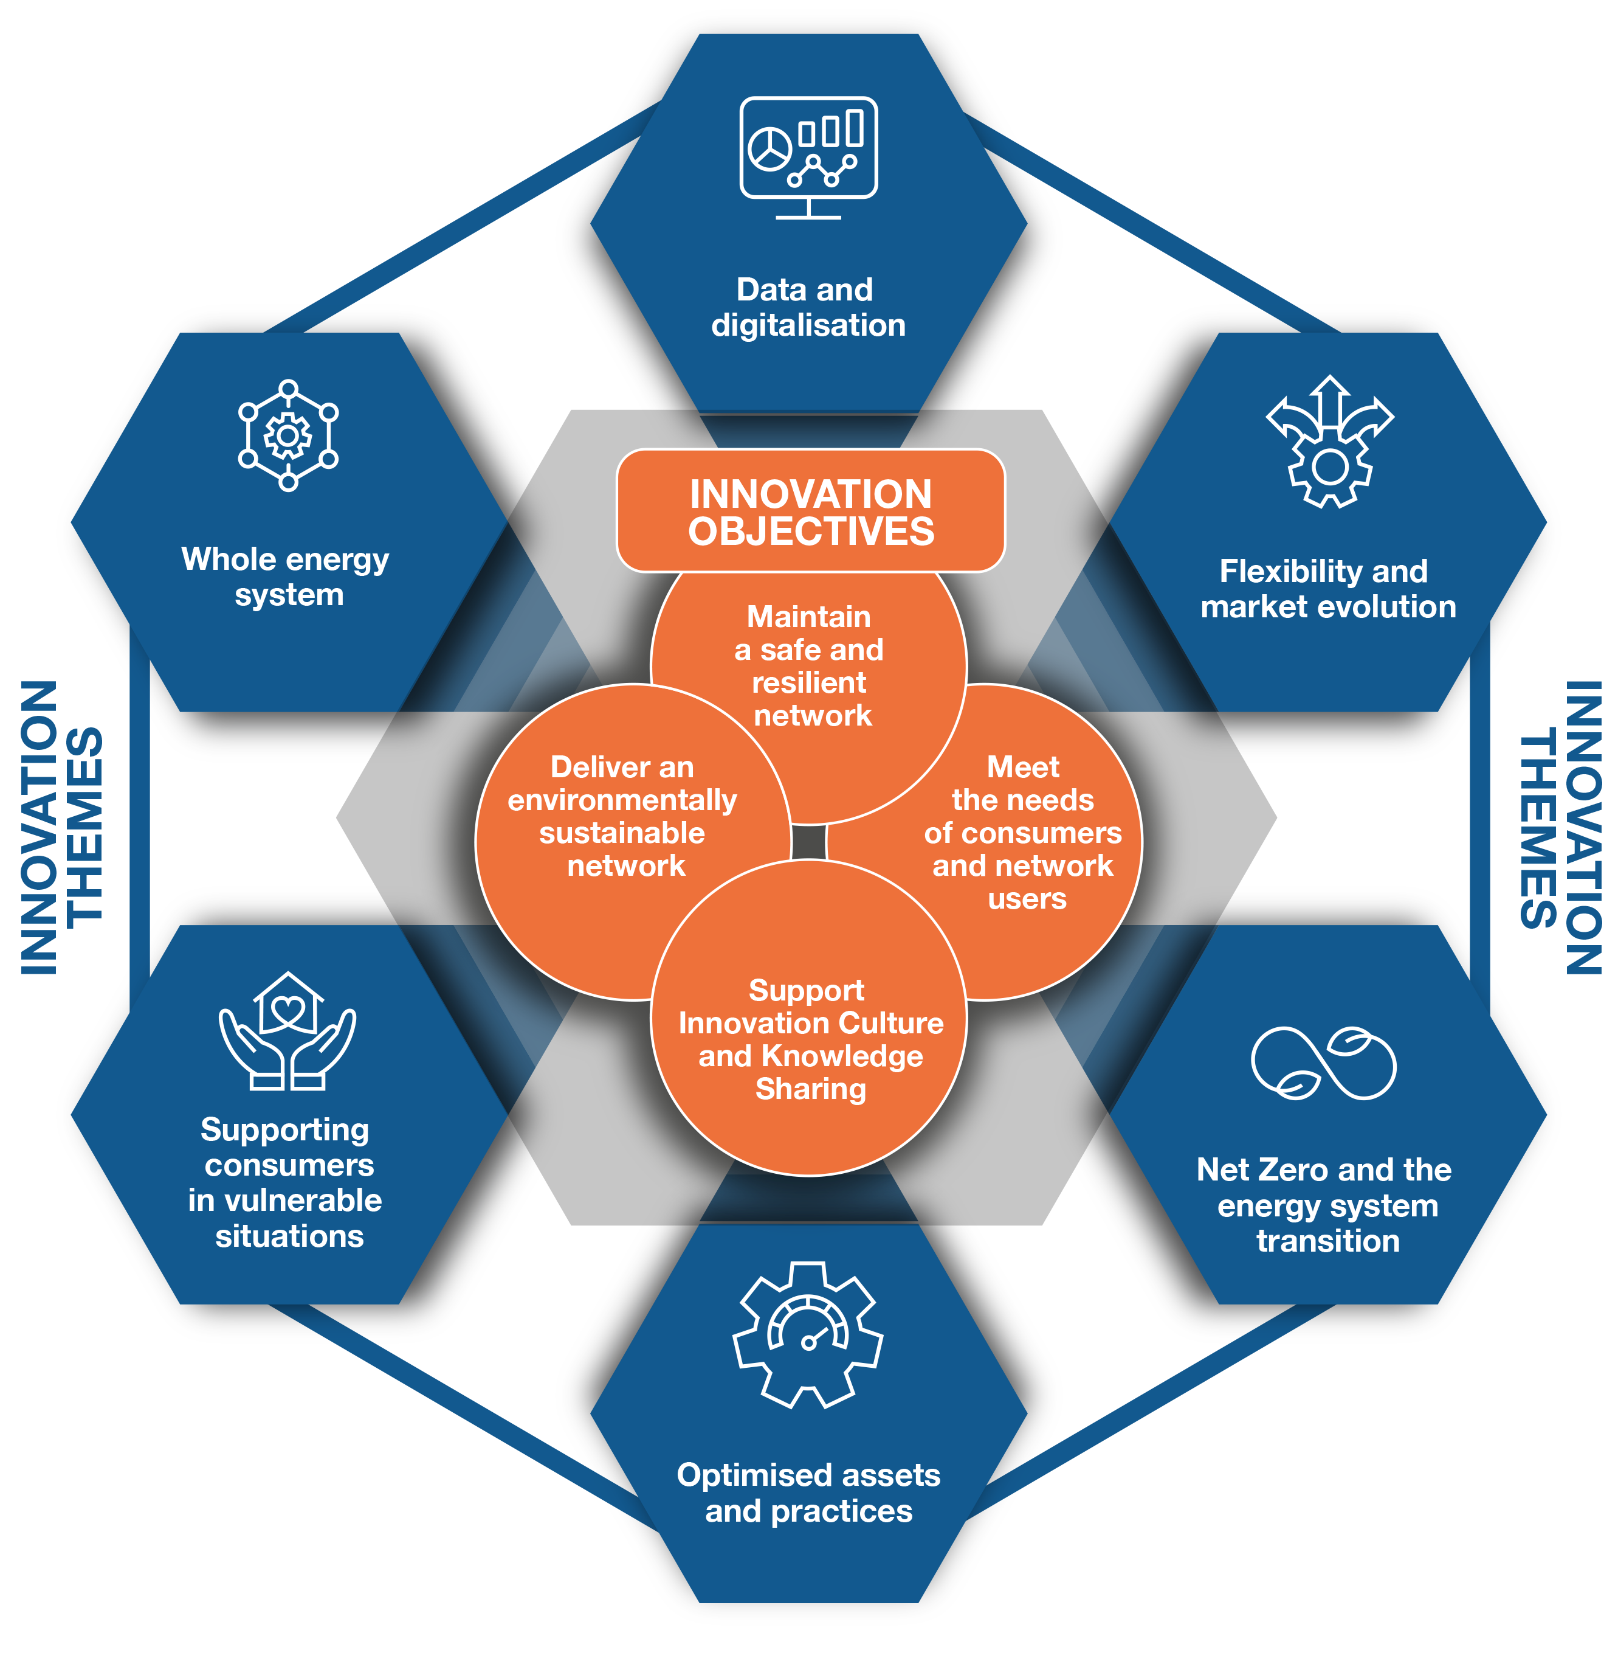
Electricity Networks Innovation Strategy – Themes
The strategy is delivered through innovation themes that translate these objectives into practical, whole‑system action, covering planning, market evolution, digitalisation, asset optimisation and consumer support.
Innovation Themes:
Data and digitalisation.
Flexibility and market evolution.
Net-Zero and the energy system transition.
Optimised assets and practices.
Supporting consumers in vulnerable situations.
Whole energy system.
While projects often align to more than one theme, each must demonstrate a clear connection to the innovation objectives to
ensure innovation effort is focused on the sector’s most significant challenges.
The shared network innovation themes set the priority areas for all networks and provide a unified strategic direction.
The strategy sets out a clear and coherent description of the challenges, innovation gaps and policy demands facing energy networks. It organises these needs through the innovation horizons, which show when key innovation gaps need to be addressed to meet the demands set by Clean Power 2030 (CP2030) and enables the delivery of a fully decarbonised system by 2050.

Slide 10
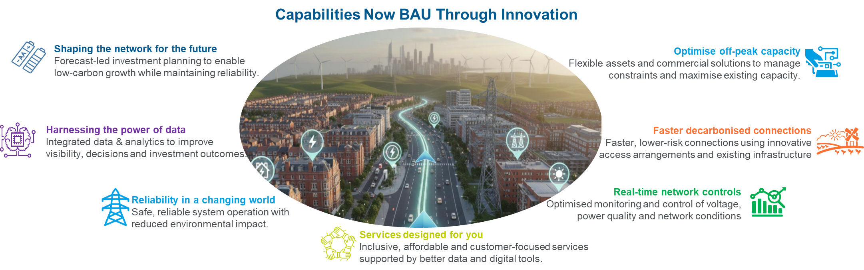
Innovation to date – Turning ideas into capabilities
Innovation is the critical foundation of our network’s transformation. The essential capabilities we depend on today exist because sustained innovation has driven system change and enabled confident progress. Over 3,000 innovation projects have tested and de‑risked new approaches, improved processes, and ensured the transition works for everyone. Among the many capabilities delivered, networks are showcasing seven capabilities that have now been implemented into BAU that would not have been possible without innovation.

Slide 11
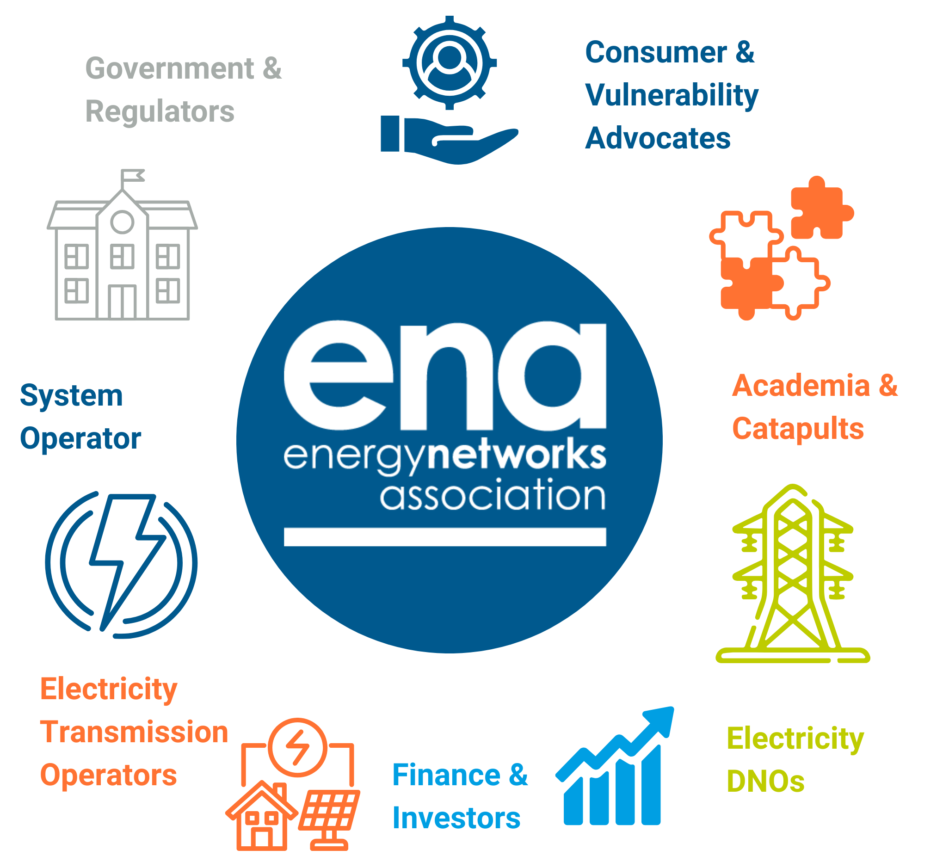
Electricity Networks Innovation Strategy – Horizons Development
Innovation Horizons
The strategy then outlines how innovation will continue to shape future networks. The innovation horizons align with government policy milestones for 2030 and 2050, providing a clear framework for when innovation gaps must be addressed to enable a fully decarbonised system.
Horizon 5 (2026–2030): delivering capabilities for CP2030.
Horizon 15 (2031–2040): aligned with Energy Networks Innovation Taskforce (ENIT) mission outcomes.
Horizon 25 (2041–2050): supporting long‑term Net-Zero 2050 obligations.
The strategy identifies the system challenges, policy drivers and priority areas for targeted innovation at each stage of the transition.
These insights will be presented in a new online visual on the Smarter Networks Portal (SNP), giving stakeholders a clear, evidence‑based view of progress to date and the innovation gaps that remain. The 2026 Strategy also incorporates the Energy Networks Innovation Taskforce (ENIT) missions, ensuring a coherent, whole‑system approach to accelerated innovation, collaboration and commercialisation.
Developed through broad stakeholder engagement, this provides a unified, stakeholder‑aligned innovation pathway that will guide networks across all three horizons.

Slide 12
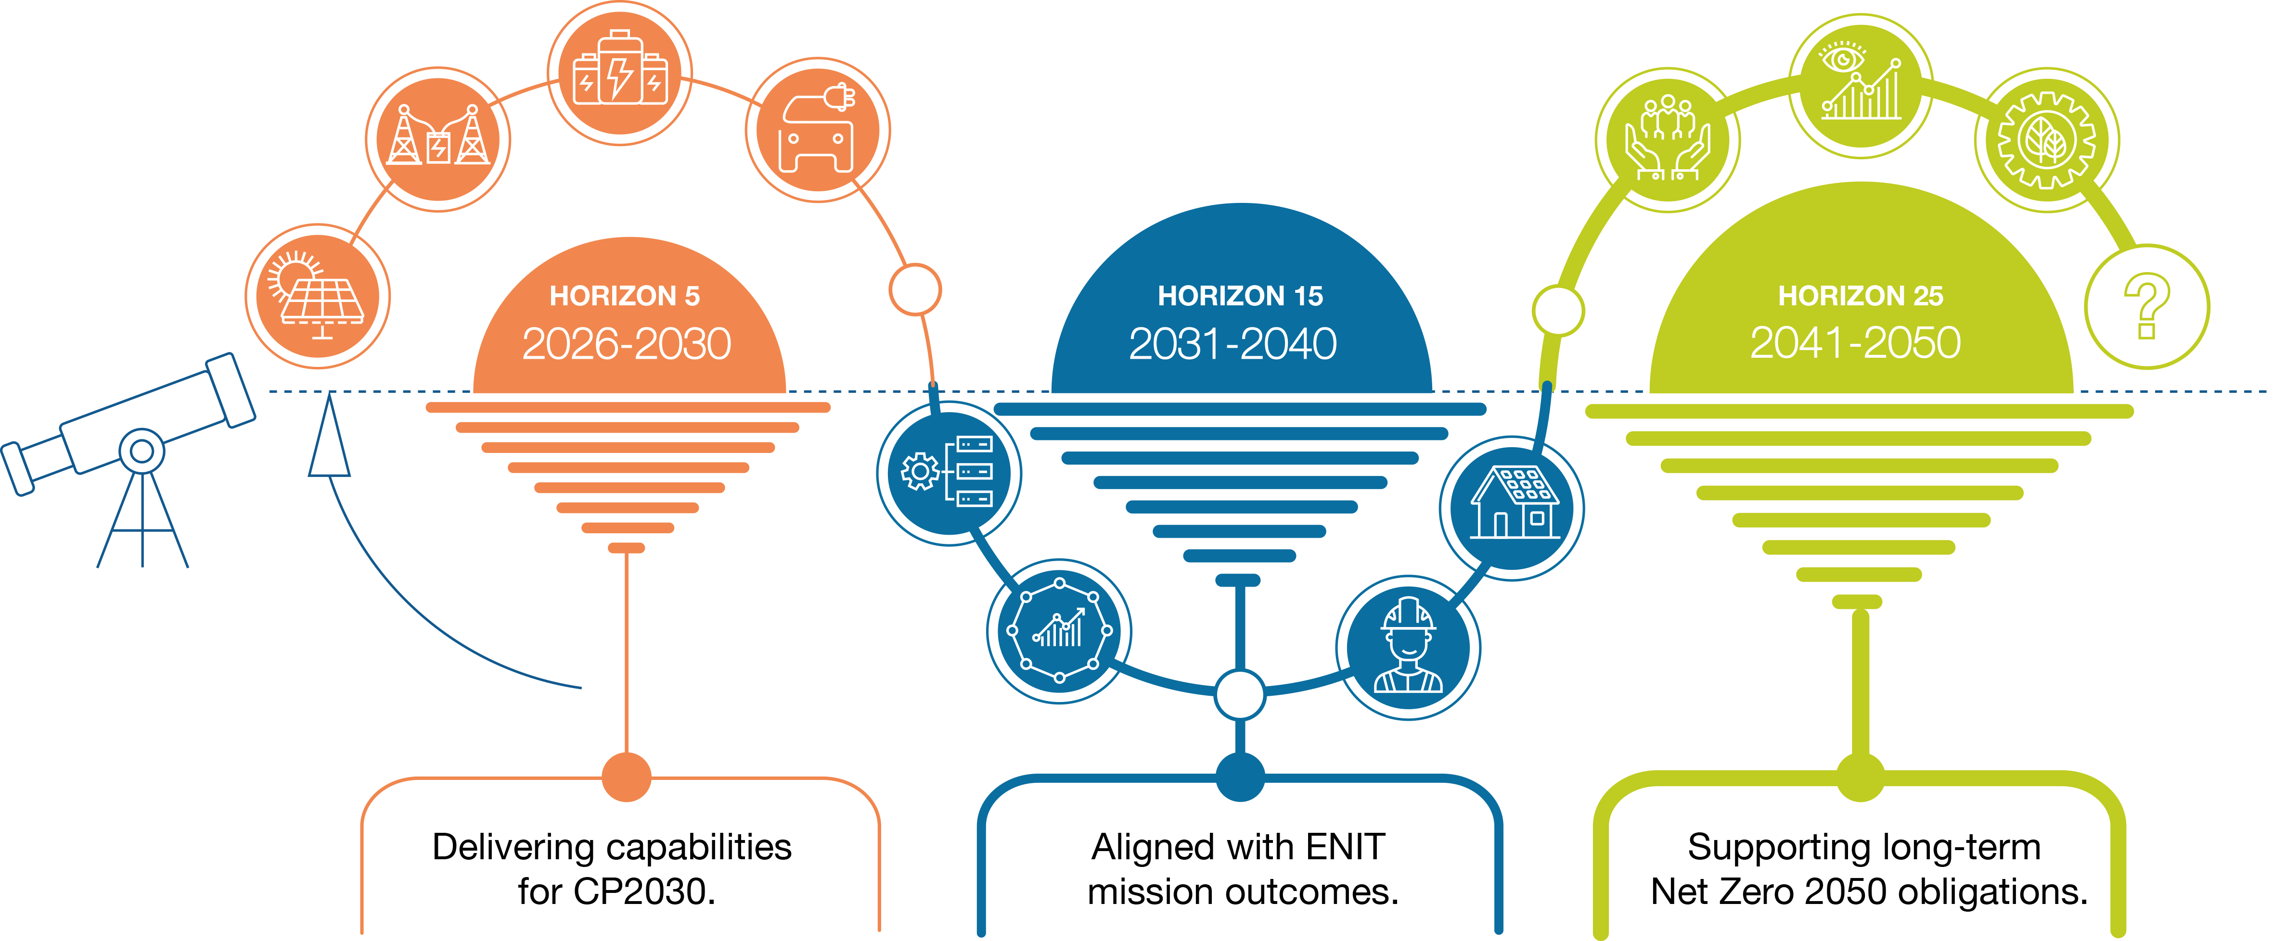
Innovation Horizons
The Electricity Networks Innovation Strategy is structured around three clear time horizons, guiding the energy networks on the enablers required to meet near‑term commitments while transforming the system for a Net-Zero future. Each horizon is aligned to policy requirements and informed by the ENIT missions, reflecting the scale of innovation needed and the pace of change expected across the GB energy system.

Slide 13


Innovation Objectives
Deliver an environmentally sustainable network
Meet the needs of consumers and network users
Maintain a safe and resilient network
Support innovation cultures and knowledge sharing
These innovation objectives reflect the long‑standing priorities of transmission and distribution networks, with this iteration strengthening innovation culture and knowledge sharing by consolidating the previous framework into a streamlined fourth objective.

Slide 14
Objective
Deliver an environmentally sustainable network
Enable low-carbon infrastructure and innovative solutions at pace, delivering an environmentally sustainable network.
Building a network ready for CP2030 and Net-Zero
The transition to a smarter, cleaner and more distributed energy system requires networks to rapidly strengthen their resilience and environmental performance.
Meeting CP2030 commitments demands that networks integrate rising low‑carbon demand, manage uncertainty and deliver infrastructure efficiently and sustainably. The Strategic Spatial Energy Plan (SSEP) strengthens this by providing a national strategic blueprint that informs regional (RESP) and local planning. This enables anticipatory investment, better coordination of upgrades and more accurate forecasting of generation clusters and flexibility needs.
What this means for networks
Accelerate growth of low‑carbon infrastructure deployment to support rapid electrification of heat, transport and industry in line with CP2030 milestones.
Enhance whole‑system resilience by improving visibility, control and coordination across transmission, distribution, flexibility providers and local energy systems.
Cut environmental impact through low‑emission construction, sustainable materials, circular‑economy approaches and biodiversity‑conscious delivery.
Adapt networks to climate impacts by embedding future weather planning, thermal resilience and flood resistant design into operations and investment.
Challenges
Delivering capacity and upgrades at speed for CP2030 requires accelerating infrastructure delivery while maintaining affordability and minimising environmental and community disruption.
Managing increased variability and system complexity driven by distributed renewables, wind farms, solar farms, EV uptake, heat electrification and climate‑driven uncertainties.

Slide 15
Objective
Meet the needs of consumers and network users
Ensure affordability, high-quality service, and protection for all consumers, including customers in vulnerable circumstances.
Delivering value and inclusive outcomes for every consumer
As the energy system becomes smarter, more digital and increasingly flexible, networks must ensure that all consumers benefit, especially those who may be at risk of being left behind. Innovation plays a critical role in improving service quality, reducing costs, enabling fair access to new energy services, and strengthening protections for vulnerable households as the transition accelerates.
What this means for networks
Design services that meet diverse consumer needs, ensuring that flexibility, digital tools and new energy solutions remain accessible, intuitive and fair.
Improve identification and support for customers, using data‑driven insights and local partnerships to target assistance where it has the greatest impact.
Enhance affordability and service quality by reducing network costs through innovation, smarter operations and better use of existing infrastructure.
Ensure customer protections keep pace with system change, maintaining reliability, clarity and consumer safeguards as markets, tariffs and technologies evolve. Identifying and responding to emerging forms of vulnerability or changes in the marketplace to avoid customer exclusion.
Challenges
Avoiding new forms of exclusion as digitalisation, flexibility markets and low‑carbon technologies become more embedded in the system.
Balancing affordability and investment, ensuring cost‑efficient delivery while upgrading the network for a more electrified, interactive system.

Slide 16
Objective
Maintain a safe and resilient network
Future‑proofing reliability and operational performance.
Strengthening security, reliability and flexibility across a transforming system
As electricity demand grows and the system becomes more decentralised, networks must maintain high standards of reliability while enabling a more flexible, dynamic energy system. Innovation supports smarter operations, enhanced monitoring, and coordinated approaches that keep the system secure, resilient to shocks, and capable of responding to rapid changes in supply and demand.
What this means for networks
Deploy advanced monitoring and control to improve real‑time visibility of network conditions and support faster, data‑driven operational decisions.
Enhance system flexibility by integrating flexible assets, supporting NESO coordination, and unlocking the value of demand‑side and distributed resources.
Strengthen cyber and physical security measures to protect critical infrastructure as digitalisation and automation increase.
Ensure reliability through smarter use of existing capacity, reducing constraints and improving network performance without excessive reinforcement.
Challenges
Managing increasing operational complexity driven by variable renewables, electrified demand and more active consumers.
Maintaining high reliability and security while upgrading networks, integrating new digital systems and adapting to evolving cyber‑risk landscapes.

Slide 17
Objective
Support Innovation Cultures and Knowledge Sharing
Embed continuous learning, skills development, and cross‑sector collaboration; move from pilots to repeatable scaling with knowledge shared openly on our SNP platform.
Embedding a strong culture of innovation for a future‑ready workforce
Delivering a Net‑Zero ready energy system requires innovation cultures that are open, collaborative, and capable of adapting at pace. Networks already employ over 26,000 people, including around 1,500 apprentices, and will require a significantly expanded and evolving skills base to meet future challenges. Cultures that value learning, knowledge sharing and continuous improvement ensure that the workforce, current and future, can develop the capabilities needed to turn innovation into scalable, day‑to‑day delivery.
What this means for networks
Strengthen an organisation‑wide innovation mindset, where learning, experimentation and continuous improvement are embedded in everyday work.
Support ongoing workforce development, ensuring people have access to opportunities to build the emerging skills needed for increasingly digital, flexible and data‑driven operations.
Promote open knowledge sharing, enabling insights from projects to be reused, transferred and scaled across teams, companies and sectors.
Foster broad collaboration, recognising the importance of working with partners, including those in education and training, to ensure the sector can access and grow the talent needed for future innovation.
Challenges
Ensuring the workforce can keep pace with rapid technological and operational change, while maintaining consistent capability across regions and organisations.
Avoiding fragmented learning, where insights remain siloed and innovations struggle to scale without shared frameworks, language or expectations.

Slide 18





Shared network innovation themes
Data and digitalisation
Flexibility and market evolution
Net-Zero and the energy system transition
Optimised assets and practices
Supporting consumers in vulnerable situations
Whole energy system

Slide 19


Theme
Data and digitalisation
Building intelligent, cyber‑resilient digital systems that unlock new data insights, improve operational decision‑making and ready the network for future system challenges.
Digitalisation is reshaping how networks plan, invest and operate. Better data, tools and interoperability enable networks to respond to rising system complexity, faster electrification and greater variability. Digital capabilities are essential for:
Stronger anticipatory investment, using improved data and forecasting to identify needs earlier and target proactive reinforcement.
Faster, insight‑driven operations through automation, AI and advanced monitoring.
Better whole‑system coordination, using real‑time and spatial data to align local, regional and national plans.
Delivering these benefits depends on strong data foundations. To unlock the full value of digitalisation, networks must strengthen:
Data quality and completeness.
Interoperability and common standards.
Strong data governance and robust cybersecurity protections.
These foundations must be in place before advanced applications—such as AI, digital twins and predictive analytics—can succeed at scale.
Digitalisation also underpins whole‑system planning and policy alignment. Integrating network data with emerging spatial planning frameworks, such as:
Strategic Spatial Energy Plan (SSEP).
Regional Energy Strategic Plans (RESP).
Transitional tRESP datasets.
Digitalisation supports better forecasting, coordinated investment, and clearer visibility of future generation and demand hotspots.
The Electricity Networks Innovation Strategy therefore prioritises:
Scalable, interoperable digital solutions.
Strengthened cyber governance and digital security.
Embedding digital tools into planning, operations and customer services.
Integrating spatial planning data to support whole‑system investment decisions.

Slide 20

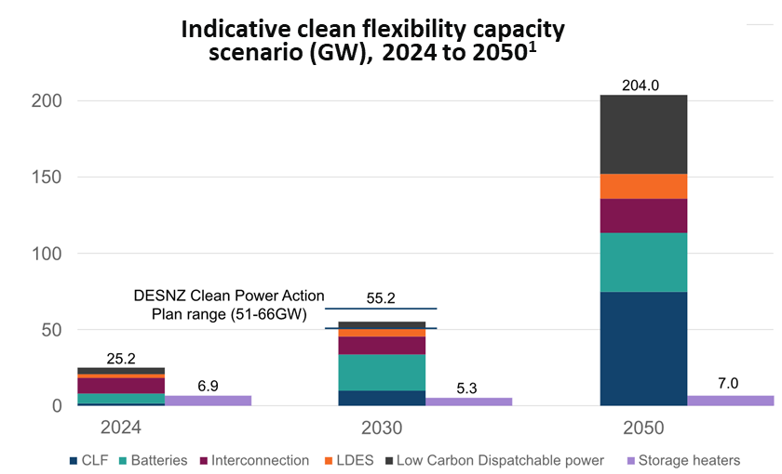
Theme
Flexibility and market evolution
Driving innovation that unlocks clean flexibility across the electricity system, enabling faster low‑carbon connections and more efficient use of renewable energy as the UK scales toward its 2050 targets.
The shift to a clean, secure electricity system means flexibility must grow at a pace that matches the UK’s ambition for 100% clean power by 2030, with at least 95% of electricity from low‑carbon sources under the government’s Clean Power 2030 Action Plan. As renewable generation expands rapidly, networks will increasingly rely on flexible resources to smooth variability, maintain system stability and ensure customers benefit from a resilient, affordable energy system.
Innovation therefore has a critical role in opening up new forms of flexibility and creating markets that reward consumers, communities and businesses for participating.
Government policy is already reshaping expectations for flexibility across the electricity sector. The Clean Flexibility Roadmap¹ sets out a path to a two‑ to three‑fold increase in clean flexibility by 2030, targeting 51–66 GW of capacity, and rising to 204 GW by 2050 through technologies such as batteries, consumer‑led flexibility, interconnection and long‑duration storage. Alongside this, new regulatory changes demonstrate how digital tools and market reforms are enabling broader participation in flexibility markets across 2026 and beyond.
As electrification accelerates through heat, transport and industrial decarbonisation, variability in demand and generation will continue to increase. Developing smarter market frameworks, improved forecasting and more dynamic commercial models will help networks make better use of distributed flexibility, support faster low‑carbon connections and defer reinforcement where possible. By enabling flexible solutions to support traditional network upgrades, innovation can help deliver a system that is cleaner, more efficient and better aligned to the UK’s long‑term Net-Zero goals.
¹Clean flexibility roadmap - GOV.UK

Slide 21


Theme
Net-Zero and the energy system transition
Facilitating and accelerating the UK’s transition to Net-Zero and beyond to an inclusive, fully sustainable energy system.
The UK’s transition to Net-Zero requires an inclusive, fully sustainable energy system and a fundamental shift in how electricity networks plan, operate and coordinate change. Government policy is accelerating this transition. The Clean Power 2030 Action Plan commits to clean power meeting all of Great Britain’s electricity demand by 2030, with at least 95% of generation coming from low‑carbon sources and no more than 5% from unabated gas.
At the same time, the Clean Flexibility Roadmap sets out the need to grow clean flexibility to 55–66 GW by 2030¹ and much higher by mid‑century, reshaping how networks balance variability and support whole‑system decarbonisation. Innovation is central to delivering this transition at pace: testing new technologies, trialling new planning and coordination approaches, improving asset visibility and creating business‑as‑usual solutions that prepare the system for the future.
A crucial part of this transition is stronger transmission system integration. As offshore generation zones expand and power must be transported over longer distances, networks will need to support more complex long‑distance transfers and maintain system stability under higher levels of renewable penetrations. Enhanced coordination between transmission and distribution, improved inertia and stability management, and new control approaches will be essential to keep the system secure and reliable as power flows become more dynamic.
Strengthening interoperability and asset visibility, in line with Ofgem’s Flexibility Market Asset Registration (FMAR) work and the emerging asset visibility register, will provide consistent, trusted data foundations for flexibility participation across the sector. As the energy system evolves, innovation also needs to ensure markets become more inclusive and consumer‑centred, so flexibility opportunities remain accessible, well‑protected and aligned with changing digital requirements shaped by FMAR.
Ultimately, achieving clean power by 2030 and Net-Zero by 2050 is not only about decarbonising supply—it is about creating a flexible, resilient and affordable system shaped around the needs of consumers, local areas and sectors across the economy.
¹ clean-flexibility-roadmap

Slide 22

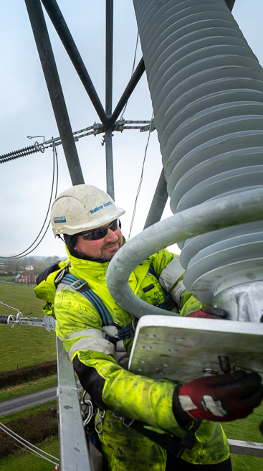
Theme
Optimised assets and practices
Developing and implementing industry-leading techniques for optimising existing core business and adopting new technologies.
Innovation in asset management and operational practices is essential for preparing the electricity system for the scale, speed and complexity of the Net-Zero transition. As the system transforms, networks must operate more dynamically, manage new forms of variability and deliver sustained reliability under rapidly changing conditions. Optimising assets and practices is therefore about efficiency and ensuring the system is resilient, future‑ready and capable of supporting accelerated low‑carbon deployment.
Over the next decade, networks will need to adopt new approaches that strengthen asset health, improve visibility and support more agile operational decision‑making. This includes expanding monitoring capability, integrating digital tools that improve predictive maintenance, and deploying new technologies that extend the performance and resilience of existing infrastructure. These improvements are vital for keeping pace with rising electrification, growing connection demand and increasing system variability.
A key priority will be enhancing climate resilience, as networks face more frequent and severe storms, flooding and heat events. Strengthening asset hardening, improving situational awareness and adopting adaptive operational strategies will be critical to maintain reliability and protect customers as environmental risks intensify.
To support the UK’s system transformation, we need to evolve how we manage assets so we can:
Deliver the infrastructure upgrades needed to support a clean, flexible electricity system.
Increase digital and physical asset resilience as operational conditions become more dynamic.
Enhance monitoring, diagnostics and real‑time situational awareness across the network.
Improve predictive maintenance and risk‑based interventions to maintain reliability at scale.
Reduce environmental impact through improved asset lifecycles and resource efficiency.
Strengthen cyber‑secure operation of digital tools and connected assets.
Innovation accelerates these improvements by providing a safe space to trial, validate and de-risk new methods before they are scaled across business‑as‑usual processes. It reduces delivery risk by demonstrating how emerging technologies, analytics and operational models can improve reliability, resilience and efficiency at pace. As the pace of change in the system increases, innovation will increasingly drive the optimisation of assets and practices, enabling networks to deliver a secure, sustainable and affordable energy system for the future.

Slide 23

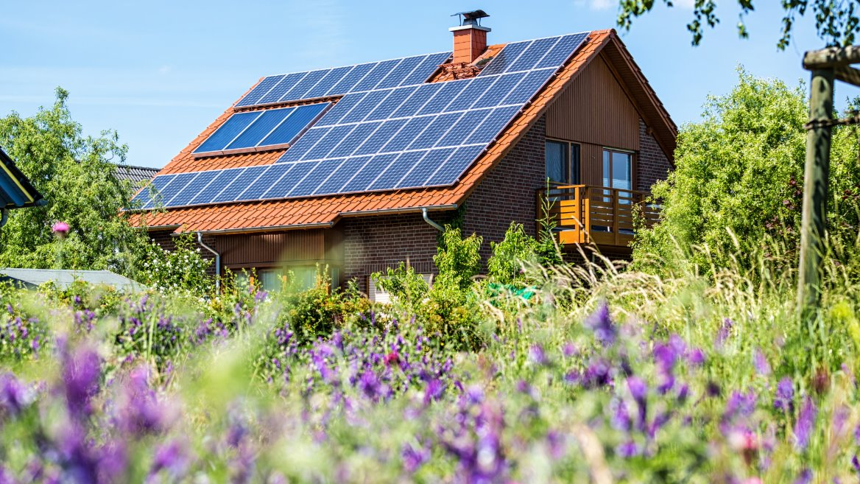
Theme
Supporting consumers in vulnerable situations
Ensuring a just, electricity‑reliant Net-Zero transition by proactively identifying vulnerability, protecting consumers, and embedding equitable access into network change.
​
Even when networks do not engage directly with consumers, innovation projects can still deliver tangible benefits, improving resilience, reducing costs, preventing outages and simplifying participation, so that no one is left behind as the system becomes cleaner, smarter and more dynamic. To achieve this, networks can:​
Proactively identify vulnerability using data‑led, locally granular indicators and target support where impact is greatest.​
Design for inclusion: co‑design trials and deployments to avoid unintended consequences and keep services accessible and comprehensible.​
Strengthen outage preparedness and priority support as electrification and flexibility scale.​
As the UK decarbonises and electricity becomes the backbone of everyday life, powering heating, transport and digital services, networks must make the transition just and inclusive by proactively identifying consumers who may be at heightened risk, protecting them during change and ensuring they can benefit from new services.
Vulnerability is contextual and can arise from personal circumstances combined with system changes (e.g., new tariffs, flexible services, digital access). Innovation enables networks to anticipate where support is most needed, design change to avoid unintended consequences, and embed protections at pace and scale. With the growing reliance on electricity as we decarbonise, it is more important than ever that networks can identify and support consumers in vulnerable situations.
The Vulnerability Assessment Tool provides a consistent way to assess potential impacts of innovation on consumers in vulnerable circumstances, and the evolving Vulnerability Visualisation Tool maps vulnerability at a local level so support can be targeted where it matters most.
Assess risk consistently and visualise vulnerability hotspots for targeted interventions.​
Enable safe, simple participation in flexibility and digital services, with clear protections and support.​​
Scale proven safeguards from innovation into BAU to accelerate delivery and reduce implementation risk.​

Slide 24


Theme
Whole energy system
Enabling a more efficient, resilient Net-Zero system by integrating electricity and heat networks with other sectors and shared infrastructure.
The whole‑energy‑system approach means planning and operating our networks in a way that recognises how electricity, transport, heat, digital infrastructure and local energy systems increasingly interact.
In practice, whole‑system working enables faster, better‑targeted investment by coordinating decisions, data and operations across sectors. Shared data standards and interoperable digital platforms are essential to making this actionable, not just collaborative, by providing consistent visibility of demand, flexibility and constraints.
As the system decarbonises, distribution networks increasingly act as active system integrators, sitting at the practical interface between transport, heat, generation and customers, and playing a pivotal orchestration role in real‑time operation and planning.
Whole‑system innovation enables us to trial new ways of coordinating these changes, share digital tools, and bring successful approaches into business‑as‑usual so the system evolves coherently rather than in silos.
This includes:
Coordinated network planning, including offshore coordination, interconnection planning and joint spatial scenarios to reduce delivery risk and support faster, more efficient investment.
Aligned local infrastructure plans with cities and regions across transport, heat and development pathways.
Shared operational visibility to enable better use of flexibility and manage constraints across sectors.
Digital enablers, such as open data standards and interoperable platforms, to make whole‑system working deliverable at scale.
Tangible delivery outcomes, fewer constraints, faster and cheaper connections, reduced rework and more predictable customer journeys.
Collaboration across transport, buildings, water, telecoms and consumer groups to accelerate solutions that support Net-Zero.

Slide 25
In summary

Slide 26

ENA Innovation – Supporting and leading the way
ENA delivers a range of activities to support innovation across the energy networks.
Innovation Portal
The Smarter Networks Portal serves as a centralised hub for innovation projects.
It contains over 3,000 historical and ongoing Ofgem-funded Innovation Projects.
Network representation
ENA plays an important role representing the networks with a single, unified voice to stakeholders within and outside the sector.
Network Innovation Coordination
ENA coordinates teams across the energy networks through steering groups and meetings to prevent duplication of innovation effort.
Innovation Strategy
ENA publishes the Electricity Networks Innovation Strategy every two years – showing how network operators can innovate to support the Net-Zero transition and tackle potential challenges to the UK’s energy security.
Innovation Events
ENA runs innovation events on behalf of networks bringing innovators and networks together to help solve technical challenges. These events include the Energy Innovation Basecamp, the Energy Innovation Forum and the
Energy Innovation Summit.
Innovation Measurement Framework (IMF)
The IMF provides a methodology which enables fair and consistent assessment of innovation projects. Used by networks to report on innovation outcomes and benefits.
Energy Networks Innovation Process (ENIP)
The ENIP explains how innovation projects are delivered, how third parties can get involved and outlines the end-to-end industry led process for innovation projects.
Government and Ofgem Engagement
Supporting engagement to align goals and ensure network innovation is focused on Government’s and Ofgem’s key targets and ambitions. ENA also aims to support the ENIT outcomes when published.
Innovation Reporting
ENA publishes an industry wide Annual Innovation Summary Report every October.

Slide 27
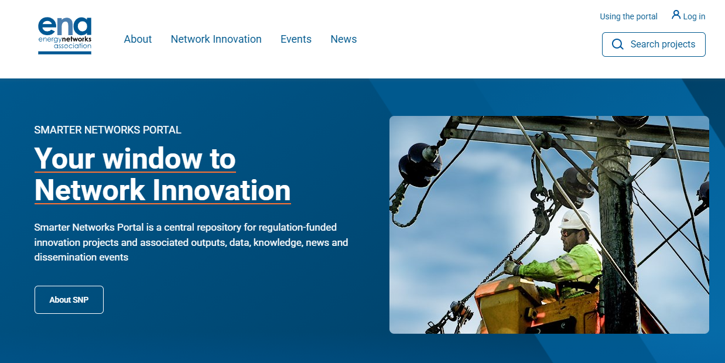
How to get involved
This strategy sets out our vision for the future, and if you’d like to get involved or learn more about network innovation you can:
Visit the Smarter Networks Portal - a centralised hub for innovation projects, with over 3,000 historical and ongoing Innovation Projects. It also provides the ability to submit new innovation ideas for the Networks to consider, so is not only a window, but also your door into Network innovation.
Join the Energy Innovation Basecamp event – every year the energy network sector presents their challenges to innovators and asks for innovative solutions.
Read the individual Electricity Network Strategies. Each electricity network publishes their own strategy which includes:
  How the electricity network coordinates their activity on innovation projects.
  The challenges and uncertainties pertinent to the electricity network over different time periods that could be addressed through innovation, and those challenges and uncertainties that are currently not addressed through innovation.
  A description of the innovative projects and plans that the electricity network intends to pursue to address these challenges and uncertainties.
Learn about the Energy Networks Innovation Process (ENIP) – which explains how innovation projects are delivered.
Coming soon – the Network Innovation Strategy online visual – showcasing BAU capabilities and more details on the enablers and challenges in each of the future time horizons outlined earlier in this document.

Slide 28
Glossary
BAU | Business-As-Usual
CP2030 | Clean Power 2030 Action Plan
ENIP | Energy Networks Innovation Process
ENIT | Energy Networks Innovation Taskforce
FMAR | Flexibility Market Asset Registration
IMF | Innovation Measurement Framework
NIA | Network Innovation Allowance
NIC | Network Innovation Competition
NESO | National Energy System Operator
RESP | Regional Energy Strategic Plans
RIIO | Revenue = Incentives + Innovation + Outputs.
SIF | Strategic Innovation Fund
SNP | Smarter Networks Portal
SSEP | Strategic Spatial Energy Plan

Slide 29

Scan me
Subscribe to our newsletter to receive updates from ENA
energynetworks.org/
subscribe
© ENA 2026

