Slide 1
EIP159_Accelerating the Adoption of People-Plant Interface (PPI) Safety Technology in Major Infrastructure Projects
EIP159
ENA Basecamp 26
Notes:
Intro about me….
We're here to go through one most persistent dangers in the Construction Industry: the interface between people and construction plant.
I see this as our unique opportunity to solve it, but we need your help…

Slide 2
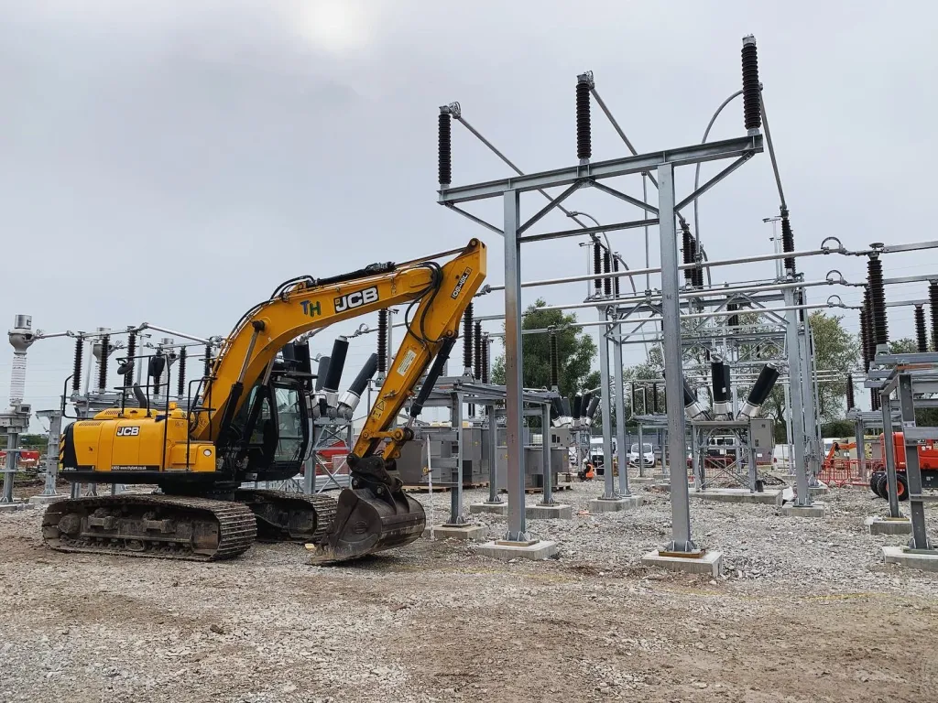
The Challenge is Growing
The Pathway to 2030: A massive national upgrade to the UK's electricity transmission network.
This means a huge increase in construction, heavy plant, and vehicle movements on our sites.
More activity inevitably means more risk.
Notes:
The 'Pathway to 2030' programme is a critical investment for Great Britain. But this monumental undertaking brings a steep rise in activity meaning more heavy plant and vehicles, more plant movements, and an increased likelihood of harm if we don't act now…

Slide 3
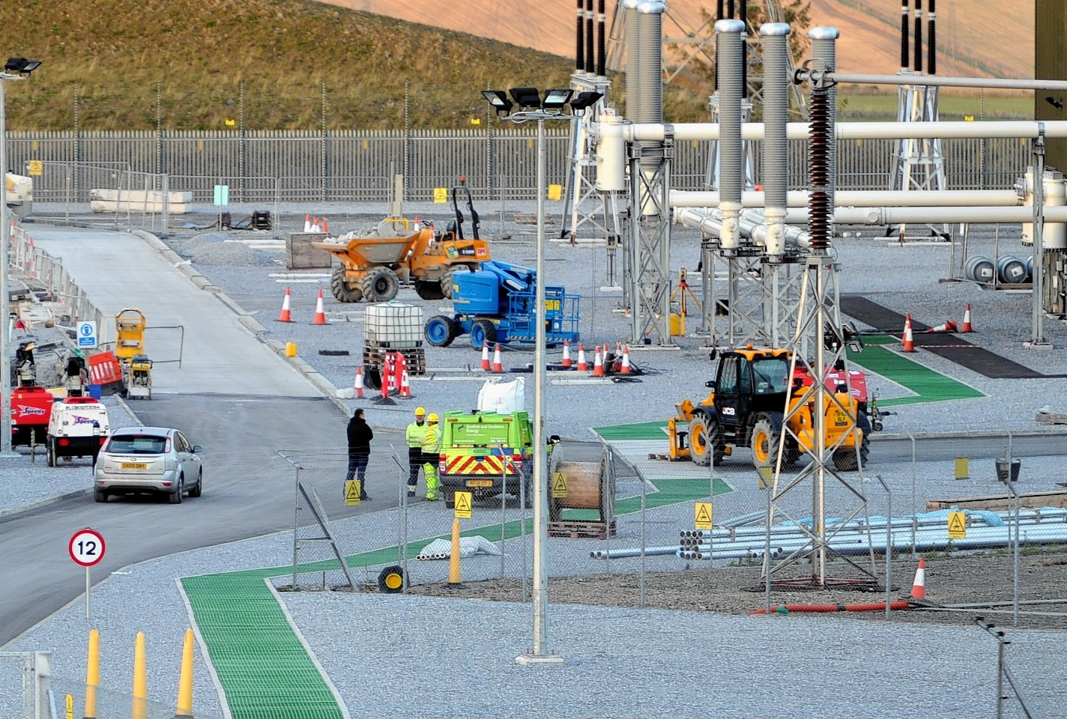
The Human Cost
Being struck by a moving vehicle is consistently a TOP 3 cause of fatal injuries in construction
Notes:
In UK industry, being struck by a moving vehicle is a leading cause of death. Thousands more suffer serious, life-changing injuries. Given the power and size of this equipment, when impact incidents happen, the outcome is almost always severe. This is not an acceptable cost of doing business!

Slide 4
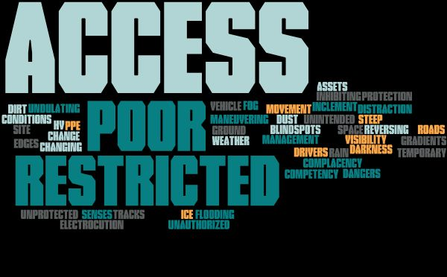
Hazards On Our Sites
Notes:
Hazards are present on our construction sites every single day. We have operator blind spots, restricted spaces, maneuvering plant and vehicles, close proximity to expensive assets and HV electricity, extreme weather worsening visibility, steep gradients, undulating ground and unprotected edges, temporary access roads and temporary access tracks, increased flooding, constantly changing site conditions, and human factors like distraction and complacency.
The current systems of managing the associated risks with the increased volume of activity is not enough.

Slide 5
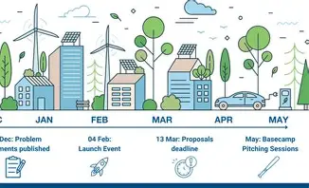
A Call For Innovation
What are we looking for?
We are seeking tested, trialable, and scalable PPI technologies to pilot within our P2030 framework.
Notes:
We are here to find a better way for the Pathway to 2030. We're looking for innovative solutions that are ready for operational pilots. Our aim is to reduce incidents and subsequent harm, improve reliability and efficiency, and to embed the most successful solutions into our minimum standards and contractual requirements, raising the bar for everyone across all projects on the framework.

Slide 6
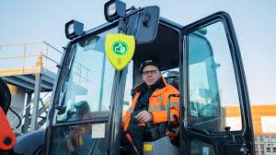
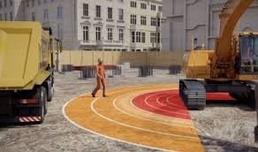
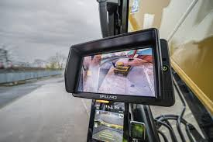
Innovate, Adopt and Adapt Technology
Technologies exist, but adoption is inconsistent.
360° / HD cameras
AI & data analytics - Human Form Recognition
Thermal Imaging & Infrared cameras & systems
Video telematics
Radar detection
3d special awareness
Digital telecommunications
Digitised thumbs-up
Wearable imaging & Smart PPE
Are there proven solutions from other high-risk industries like aviation, manufacturing, defence, or the science industry that we can adapt for our sites?
Notes:
A lot of technology to control the hazards already exists. From AI cameras that can recognize a human form to wearable technology that provides direct alerts, the tools are out there. But they are not used consistently. We need your help to identify the best-in-class solutions and create a framework for their widespread adoption. We must also look outside our own bubble—what can we learn from other industries that are tackling similar issues - providing an opportunity for potentially adaptable control measures.

Slide 7
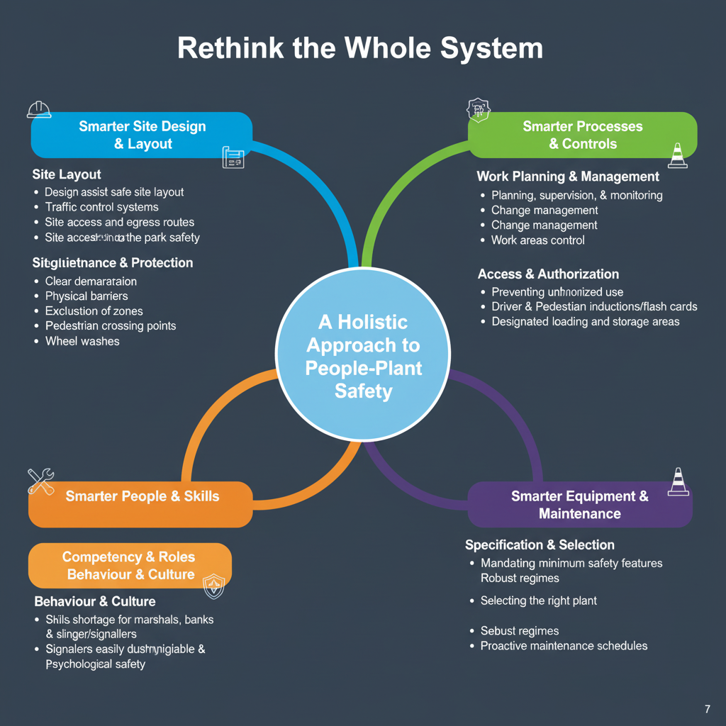
A Call To Action - Building Safely Together
Notes:
If we consider a holistic approach to people-plant safety, this provides a wider, more extensive opportunity to innovate in how we design our sites with a safe layout for vehicle operations, including site access / egress; how we manage traffic flow; denote clear demarcation of vehicle and pedestrian areas; effectively segregate plant and people; and barrier unprotected edges and embankments; how we efficiently set up safe people crossing points; install sound surfaces for vehicle and pedestrian routes; protect asset along designated routes; ensure safety clearances are maintained from substation and overhead line structures; how we maintain work area control; adhere to exclusion zones; ensure good change management as site conditions alter; that the emerging skills shortage of plant & vehicle marshals, banks persons and slinger/signallers is a gap that can be effectively closed; that signallers are easily distinguishable; unauthorised use of plant and vehicles is prevented; use flash cards and driver inductions that clearly communicate; Make sure deliveries, loading and storage is done safely; how we empower our people through better supervision and monitoring; conduct Inspections and maintenance for safe vehicles; look at plant design, safety features and selection. Car park safety: Wheel washes. The opportunities are extensive.
To solve this, we need brilliant solutions - this as well as the contractors and delivery teams who will implement these changes on the ground - is truly a collaborative initiative.

Slide 8
EIP159:
The Pilot Programme: Our Collaborative Testbed
Trial: Select 2-3 distinct technologies for a 12-week pilot on active P2030 sites.
Analyse: Collaboratively collect data on effectiveness and usability.
Recommend: Produce a formal report for our Steering Group to drive adoption
Notes:
We propose an initial pilot programme to trial the most promising solutions on live, diverse project sites. The P2030 projects will provide a real-world testbed.
We will work with you to measure what works and build the business case for rolling out the best solutions across the entire P2030 program.
Practicalities
Solutions must be designed to integrate with existing equipment
The trial methodology must not compromise existing safety standards.
Solutions should be scalable for potential rollout across multiple projects and contract partner organisations.
The solutions should not be overcomplicated
And we must consider behavioural impacts of new technologies e.g. over-reliance on detection systems.

Slide 9
Matthew King (PPI Working Group Lead): mjking@burnsmcd.com
Simon Stromberg (Innovation Dev’t & Strategy Manager): Simon.Stromberg@sse.com

