Slide 1
Jersey Electricity – inspiring a Zero Carbon future
ENA Energy Innovation Summit 2023
Enabling a digital, decarbonised energy system
01 November 2023

Slide 2
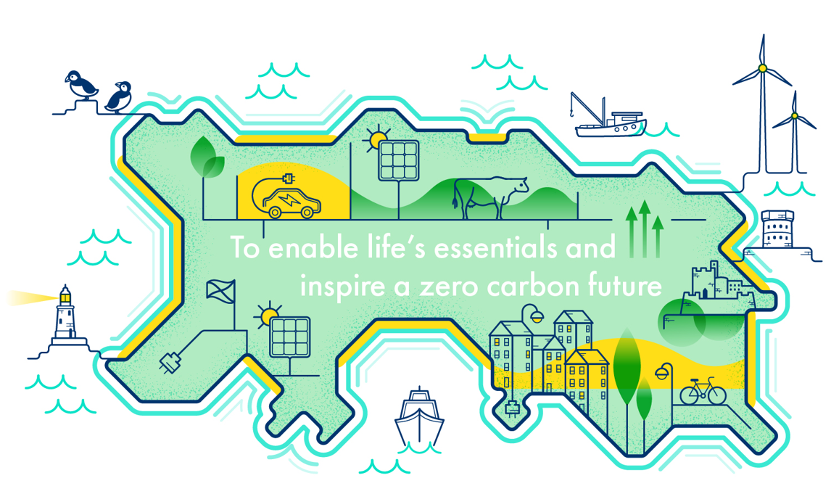
Jersey Electricity Vision

Slide 3
Agenda
Jersey Electricity Overview
The challenge of achieving carbon neutrality
Meeting the challenge – LV Network optimisation case study
Summary

Slide 4
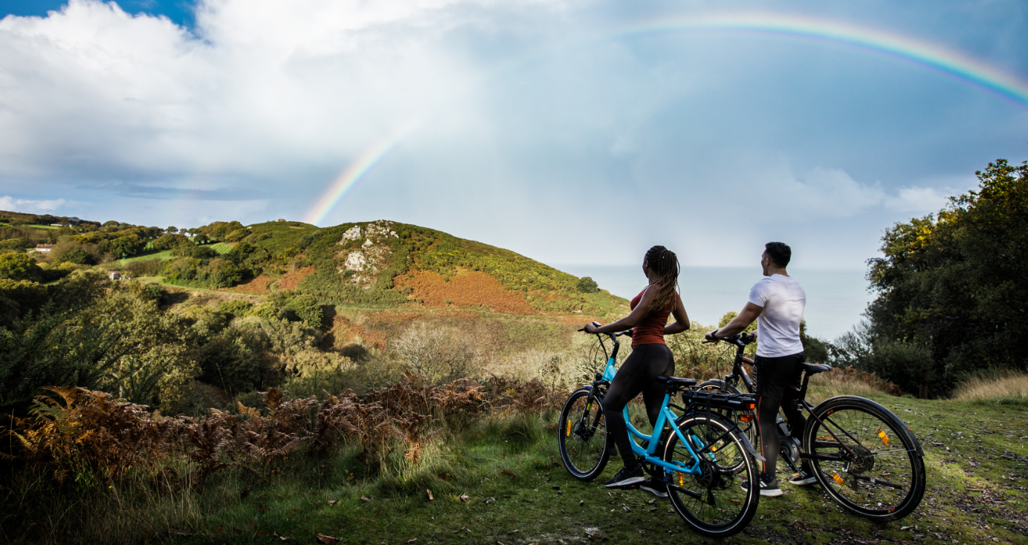
Jersey Electricity
Vertically integrated power company including:
  Supply
  Generation
  Distribution
  Metering
  Beyond the meter solutions – e.g. Heating, EV Charging
  Retail
c. 400 employees
Goal: deliver Affordable, Secure and Sustainable supply
Good deal for customers – 4 CML, Tariff 18p/kWh, c 25gC02/kWh

Slide 5
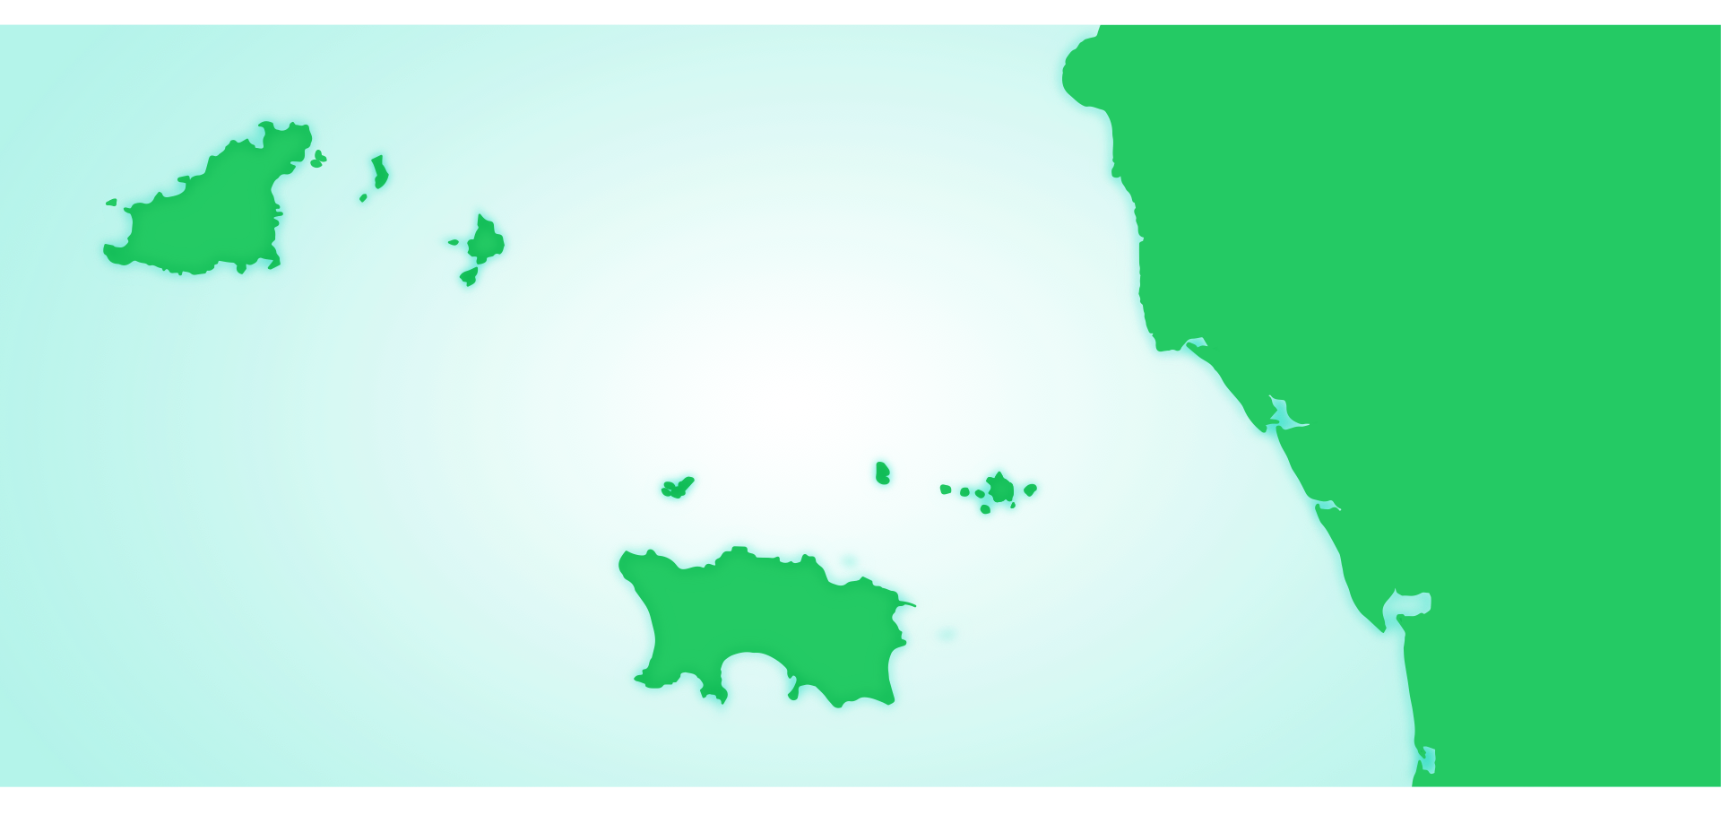
Invested in strong grid infrastructure “Zero Carbon platform”
FLAMANVILLE
CARPENTRAS SNCF
HIGHLY RESILIENT NETWORK DESIGN AND OPERATION
GUERNSEY
HUBERVILLE
VALE
HERM
TOLMER
MENUEL
BARKER’S QUARRY
KINGS MILLS
HAVELET BAY
SURTAINVILLE
SARK
PETIT BOT
GJ3 60MW
Cable | Year
N2 | 2000
N3 | 2014
N1 | 2016
GJ3 | 2019
LES ECREHOUS
ST. REMY
DES LANDES
N1 100MW
SURVILLE
LA HAYE DU PUITS
GREVE
DE LECQ
N2 90MW
JERSEY
ARCHIRONDEL
90kV
WESTERN
PRIMARY
QUEEN’S ROAD
ARMANVILLE
LA COLLETTE
GOREY
PERIERS
SOUTH HILL
N3 100MW
CONFIDENTIAL
5

Slide 6
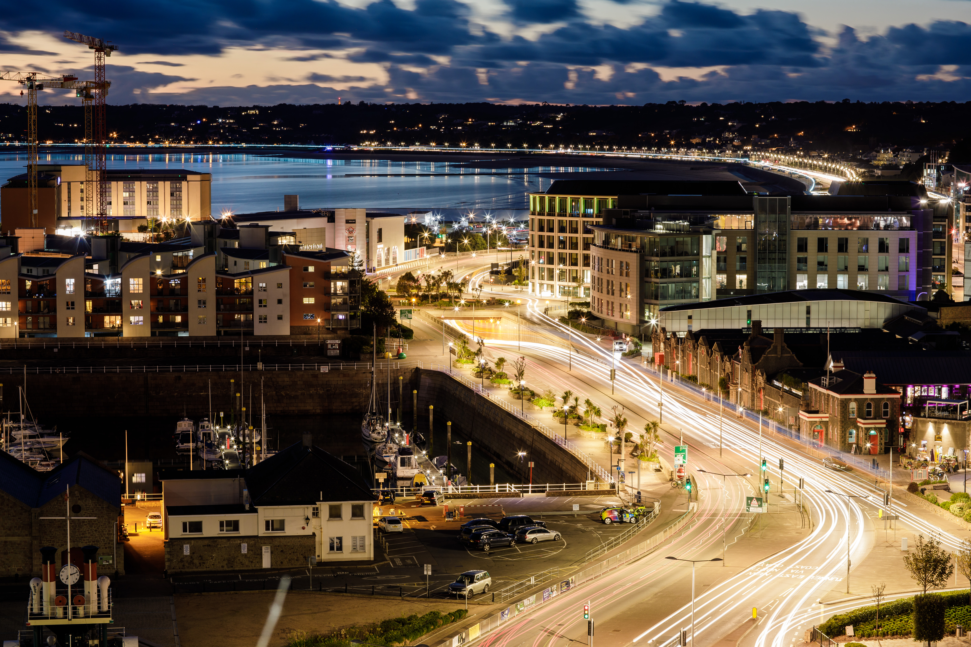
Delivering Carbon Neutrality by Leveraging our Strengths
The GoJ’s Carbon Neutral Road Map approved 29 April 2022 will transform the use of electricity for heating and transport over the next decade
Target to switch 75% of Fossil Fuel Customers to low carbon solutions by 2030
Optimising network development to meet this challenge is key
JE is a relatively small business (c 400 FTE) so we do not have the economies of scale
Need to punch above our weight by playing to our strengths – Structure & Digitalisation
Notes:
A GoJ/JE CNR group could focus on areas such as:
JE would welcome the opportunity to work closely with GoJ to help ensure the successful delivery of the CNR
JE STRIVES TO PLACE CUSTOMERS AT THE HEART OF OUR THINKING AND THE OPPORTUNITY TO WORK CLOSELY WITH GOJ CAN ONLY STRENGTHEN THIS

Slide 7
Delivering Carbon Neutrality by Leveraging our Strengths
We have a head start:
  A strong team
  Good systems
  A vertically integrated business providing valuable insights across the business
  A well invested network including 100% Smart meter coverage
  Excellent data and data models
  Network sized to accommodate much higher levels of electricity use for heating and cooking than in the UK
Notes:
A GoJ/JE CNR group could focus on areas such as:
JE would welcome the opportunity to work closely with GoJ to help ensure the successful delivery of the CNR
JE STRIVES TO PLACE CUSTOMERS AT THE HEART OF OUR THINKING AND THE OPPORTUNITY TO WORK CLOSELY WITH GOJ CAN ONLY STRENGTHEN THIS

Slide 8
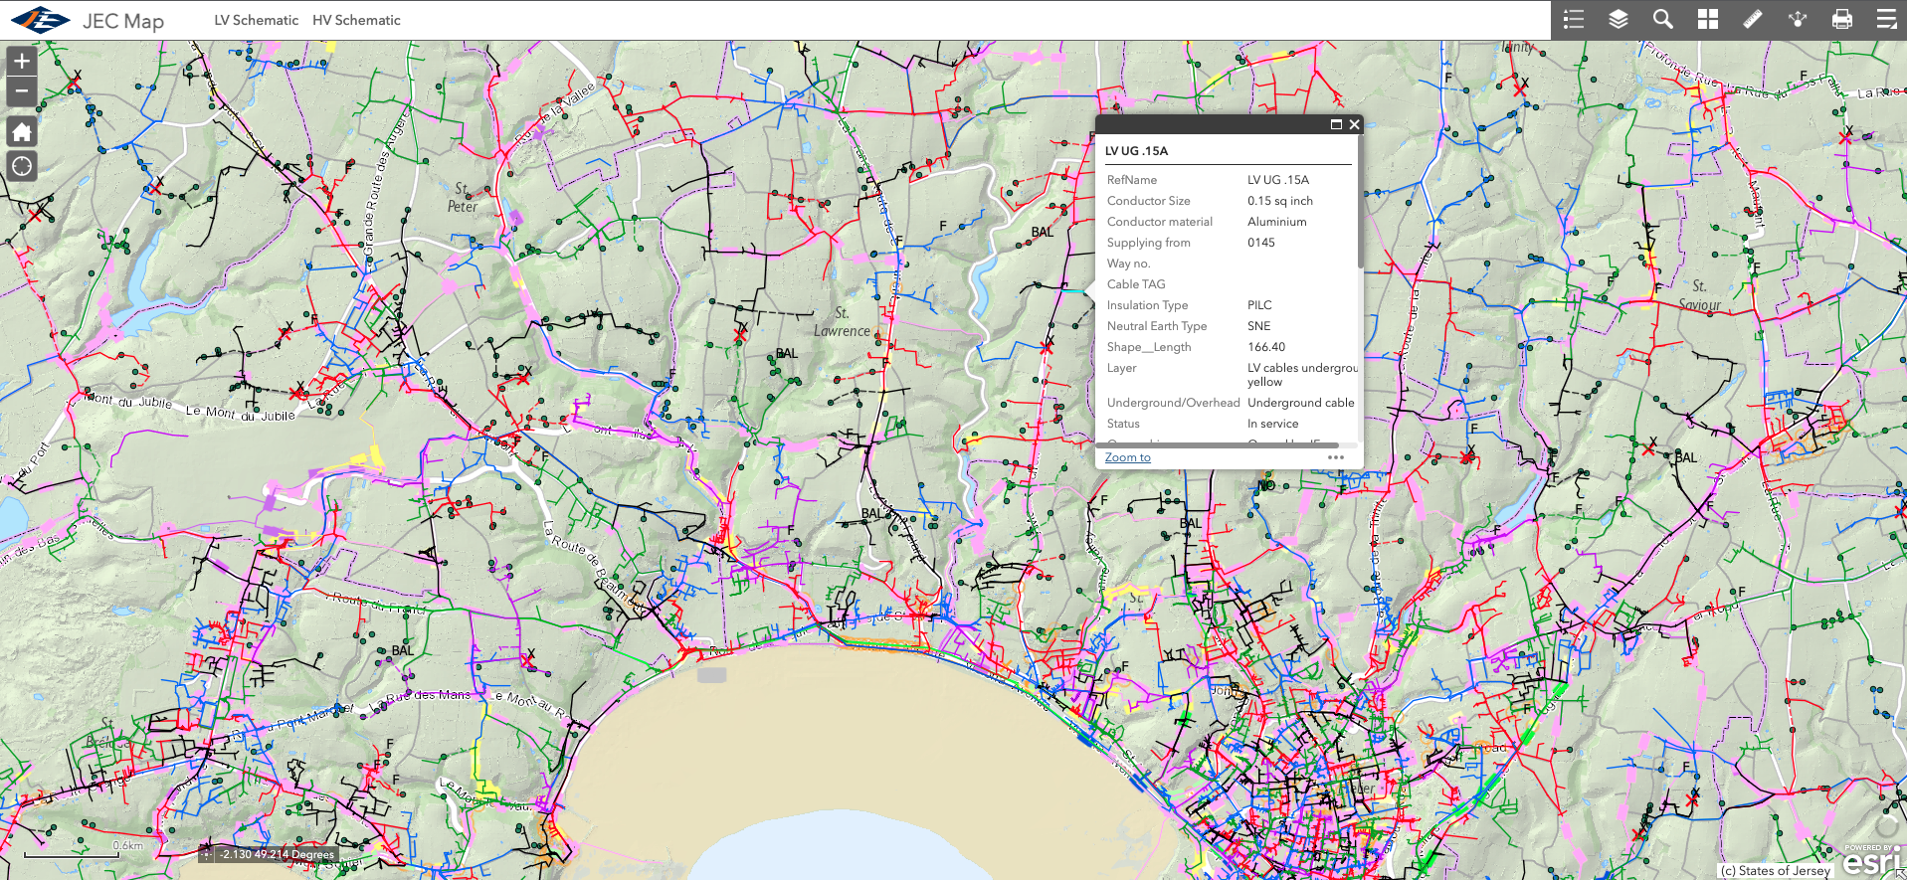
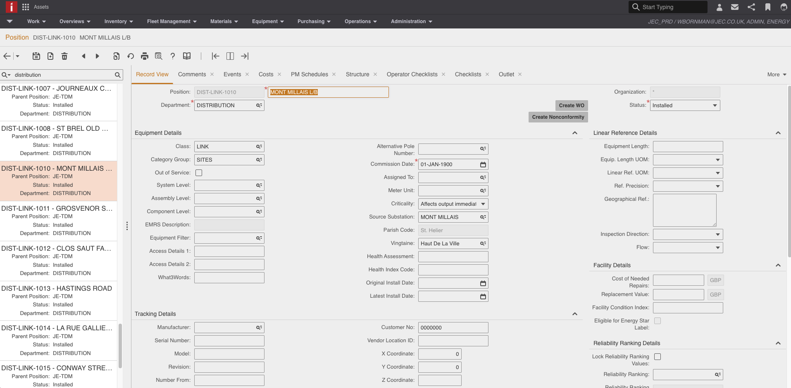




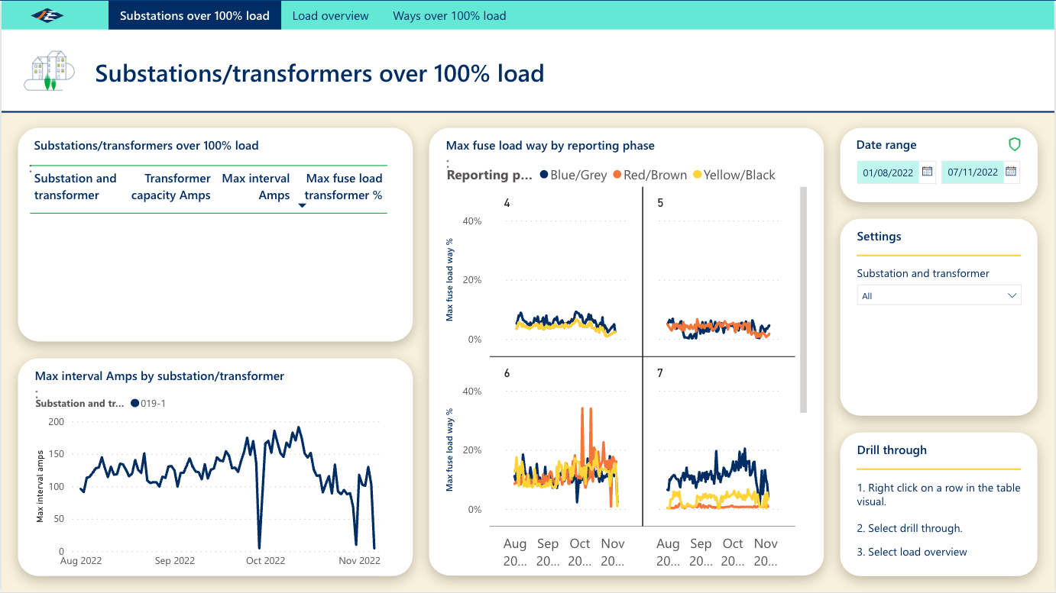
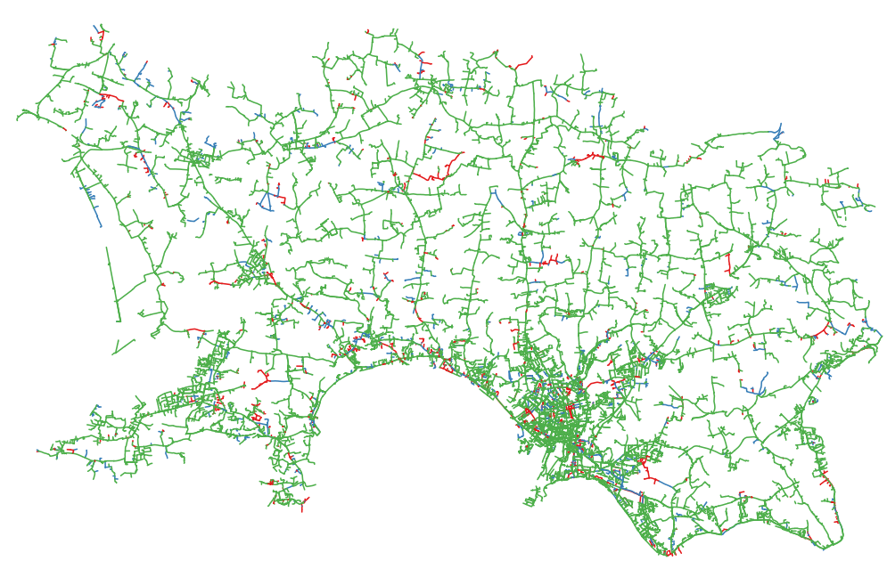

Leveraging our Strengths - LV Network Optimisation
Dynamic LV network assessment possible by leveraging data from across the business
  Consumption data
  tariff data,
  asset rating information
  asset topography data
This capability makes a huge difference, made possible by our vertically integrated structure

Slide 9
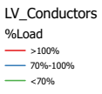
Leveraging our Strengths - LV Network Optimisation
Understand the demand on the LV network today.
Scenario analysis – E.g. Impact of different heating solutions
Create long term investment plans for network reinforcement allows:
  Managed transition
  Resource forecasting
  Minimised disruption to customers
  Avoids overloading assets
  Create customer propositions including new tariffs to optimally achieve carbon neutrality
Low Voltage Network Schematic

Slide 10
Summary
Leveraging our vertically integrated structure and the data this provides means JE is in good shape to meet the challenge of carbon neutrality
By leveraging available data means the approach is cost effective
This data is available in the UK context but in separate entities
Digitally enabled virtual integration offers huge potential in meeting the challenge in the UK
Common standards and data sharing agreements
This is just one JE example but there are many others

